Slide 1
How to Value Stocks
A Framework for Fair Valuation & Pitching
Hillsdale College Investment Club, Feb 9 2026

Slide 2

The 7-Step Valuation Process
1
Screen
Filter the universe
Key Principle
2
Understand the Business
Deep dive operations
Save valuation for last to avoid anchoring bias. Understand the business before looking at the price.
3
Understand the Finances
Analyze the numbers
4
Forensic Analysis
Hunt for red flags
5
Understand the Strategy
This framework is adapted from professional equity research methods.
Evaluate the plan
6
Stock Valuation
Price it fairly
7
Review & Finalize
Complete your thesis

Slide 3




Step 1: Screen
Filter the investment universe to find quality candidates
10-Year Revenue CAGR
Operating Margin
Net Debt / EBIT
Look for consistent, sustainable growth over a full business cycle
Higher margins suggest pricing power and operational efficiency
Assess leverage and ability to service debt comfortably
Write a brief financial summary for each screened company before proceeding.

Slide 4
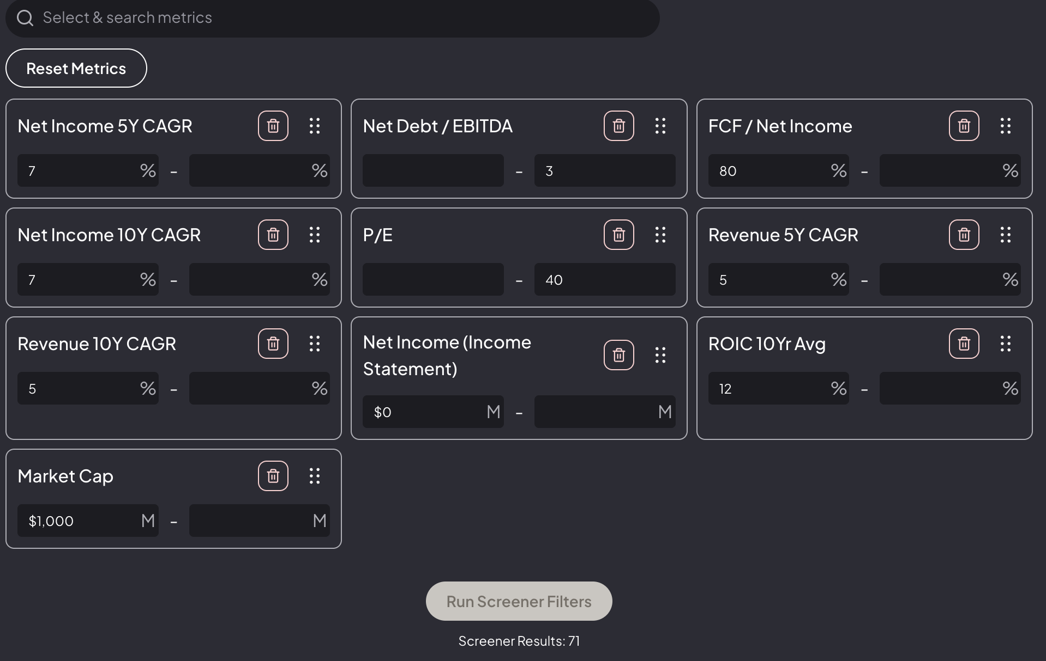
Step 1: Screen

Slide 5
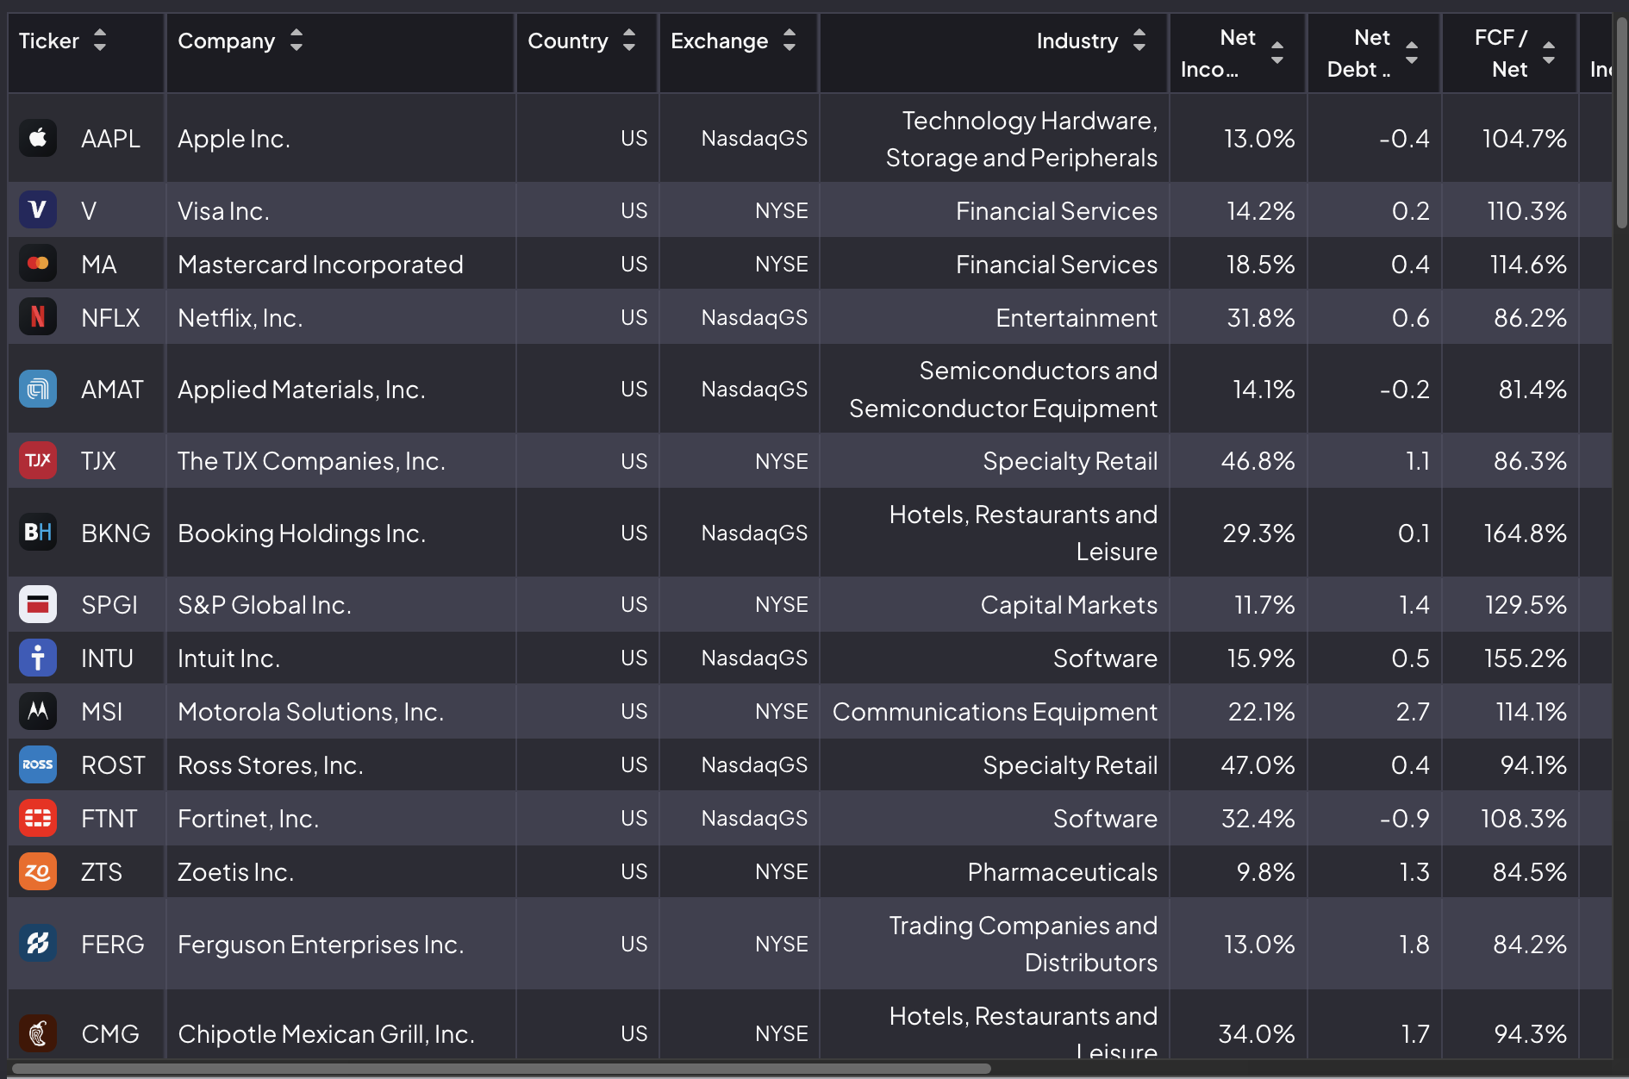
Step 1: Screen

Slide 6


Step 2: Understand the Business
Areas to Research
Key Sources
Business segments & revenue mix
Revenue characteristics (seasonal? contractual?)
Geographic exposure
Key customers & suppliers
Competitive positioning
Regulatory environment
Key Performance Indicators (KPIs)
10-K annual reports
Latest quarterly report (10-Q)
Investor presentations
8-K filings (material events)
Customer reviews & feedback
Industry research & news
Use SWOT framework for note-taking. Track questions for later investigation.

Slide 7


Step 3: Understand the Finances
What to Analyze
Techniques
Financial Position
Balance sheet strength, liquidity, solvency
Average Growth Rates
Growth Rates
Calculate 3, 5, and 10-year CAGRs
Revenue, earnings, and cash flow trends
Common-Size Statements
Margins
Express line items as % of revenue
Gross, operating, and net profit margins
Ratio Analysis
Free Cash Flow
Liquidity, profitability, efficiency ratios
Cash generation after capex
Peer Analysis
Compare against industry competitors
Be willing to pivot if financials reveal issues not apparent in screening.

Slide 8




Step 4: Forensic Analysis / Red Flags
Hunt for warning signs that could indicate trouble
Management Compensation
Conflicts of Interest
Adjusted Metrics
Excessive pay, misaligned incentives, or aggressive stock-based compensation
Related-party transactions, insider ownership concerns, dual-class shares
Scrutinize definitions of 'adjustments' in non-GAAP measures
If something feels off, dig deeper. Trust your instincts but verify with data.

Slide 9



Step 5: Understand the Strategy
Questions to Ask
Key Sources
What are management's stated priorities?
Where is CapEx being directed?
How is growth being financed?
What's the feasibility of their plans?
What are the key risks?
Regulatory filings (10-K, proxy)
Investor presentations
Earnings call transcripts
Management interviews
Industry news & analysis
Track Record Matters
Look for history of successful execution. Review ROIC, ROCE, and ROE over long periods.

Slide 10

Step 6: Stock Valuation
Now that you understand the business, assess if the price is fair
P/E Ratio
EV/EBITDA
Price to earnings - compare to history and peers
Enterprise value to EBITDA - capital structure neutral
FCF Yield
Reverse DCF
Free cash flow / market cap - cash return metric
What growth is priced in? Is it reasonable?
If a company passes all previous steps, it's likely expensive. Add to a watchlist with price alerts for potential opportunities.

Slide 11


Step 7: Review & Finalize
Final Checklist
Pitch Structure
Fill in any gaps in your research
Seek out conflicting reports
Find and understand opposing opinions
Stress-test your assumptions
Write a concise investment summary
Company overview & thesis
Business model & competitive position
Financial highlights
Valuation analysis
Key risks & mitigants
Recommendation & price target

Slide 12
"
Invert, always invert.
What's implied in the current stock price?
Charlie Munger
Reverse DCF: A Powerful Tool
Instead of forecasting growth to derive a price, work backwards from the current price to determine what growth rate the market is implying. If the implied growth seems reasonable at your required return, the stock might be interesting.

Slide 13
Key Takeaways
Screen first to narrow the universe efficiently
Understand the business before looking at price
Be skeptical - hunt for red flags
Quality companies are often expensive; use watchlists
Invert: ask what growth is implied in the price
Questions?

